Slide 1
CSSE 332 Process Creation

Slide 2
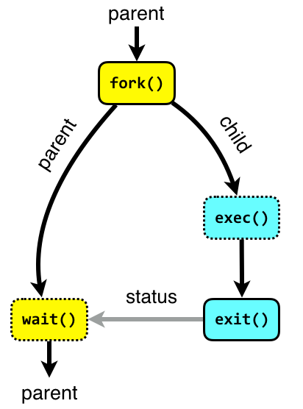

Outline
Motivation: How is a process created?
Process creation functions
exec()
fork()

Slide 3
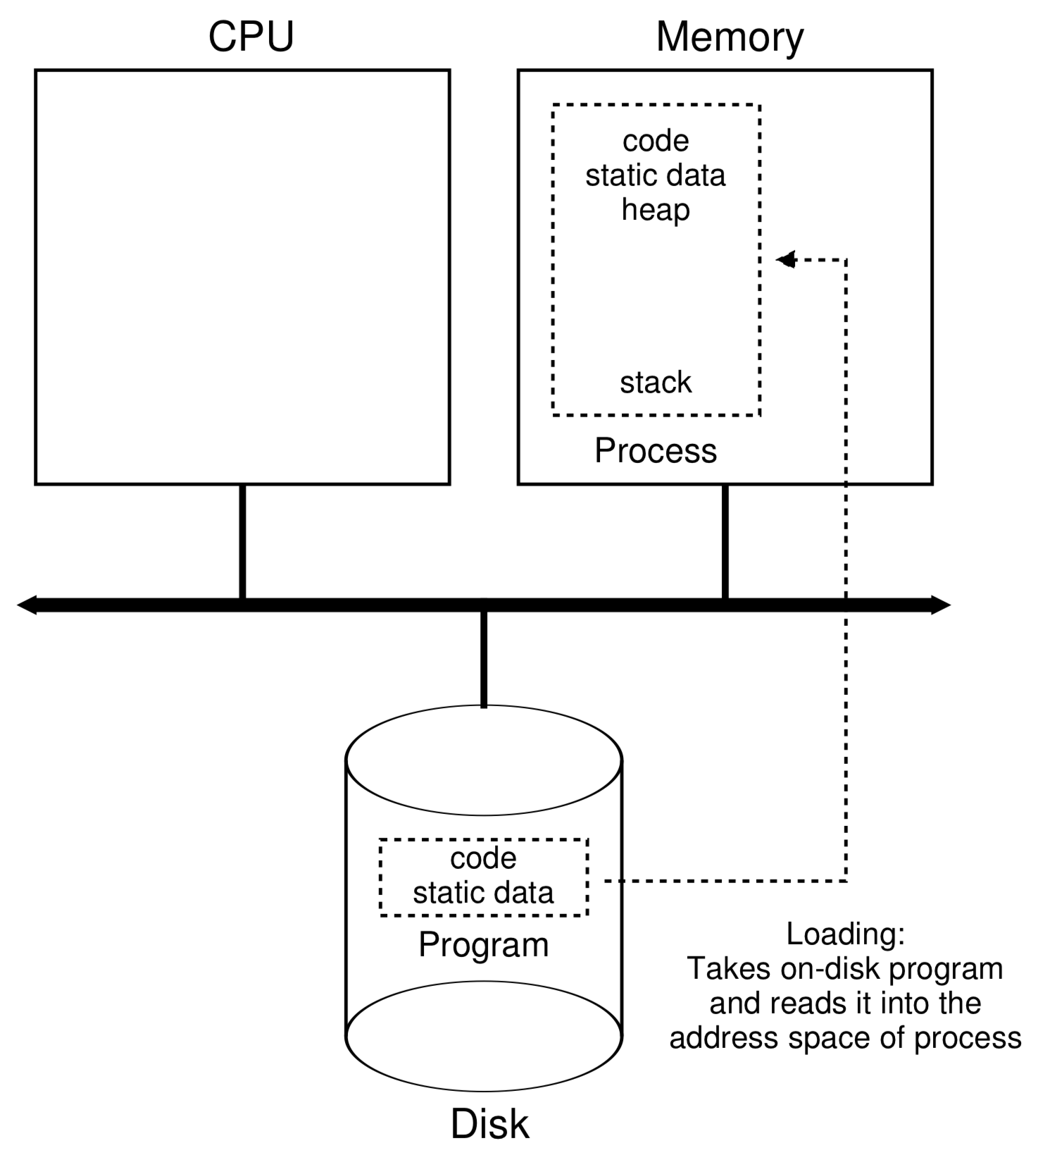
Motivation
The process is created by “double clicking”?
You need a GUI to double click. Then how the GUI is created/launched.
How the memory of a newly created process is loaded (shown in the diagram on the right)

Slide 4
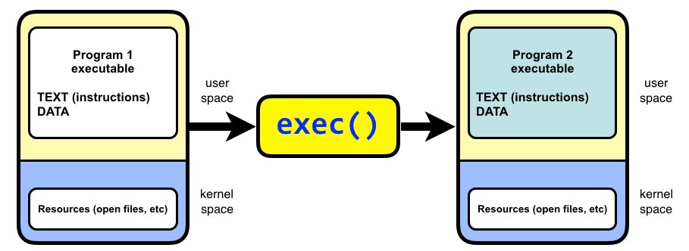
The exec family of system calls
The exec family of system calls replaces the program executed by a process.
System calls: all functions that request a resource (via OS)
When a process calls exec, all code (text) and data in the process is lost and replaced with the executable of the new program.
*all open file descriptors remains open.

Slide 5
execv
int execv(const char *path, char *const argv[]);
path
The path to the new program executable.
argv
Argument vector. The argv argument is an array of character pointers to null-terminated strings. The last member of this array must be a null pointer. The value in argv[0] is the name of the new program.

Slide 6
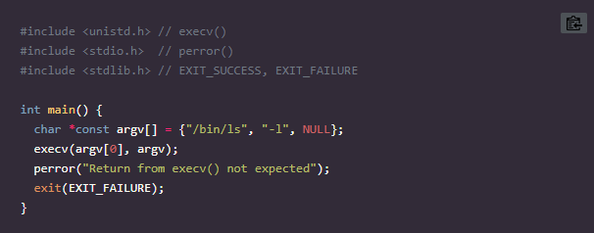
execv example

Slide 7
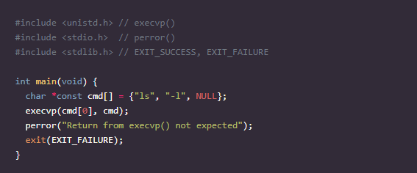
execvp
int execvp(const char *file, char *const argv[]);

Slide 8
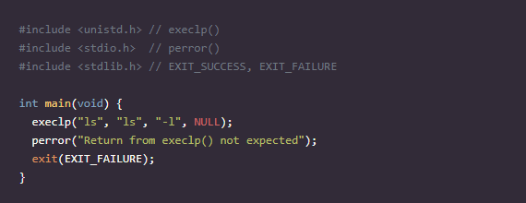
execlp
int execlp(const char *file, const char *arg, ...);

Slide 9
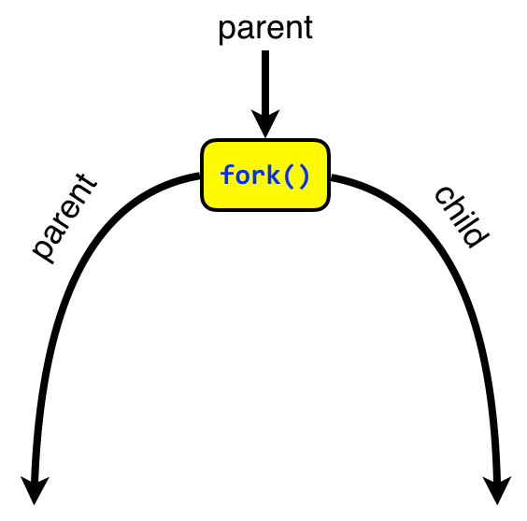
Fork
A parent process uses fork() to create a new child process.
The child process is a copy of the parent. After fork, both parent and child executes the same program but in separate processes.

Slide 10
Fork returns twice on success
On failure fork returns -1.
once in the parent
If the return value is greater than zero, the program executes in the parent process and the return value is the process ID (PID) of the created child process.
once in the child
If the return value is 0 the program executes in the new child process.
On failure fork returns -1.

Slide 11
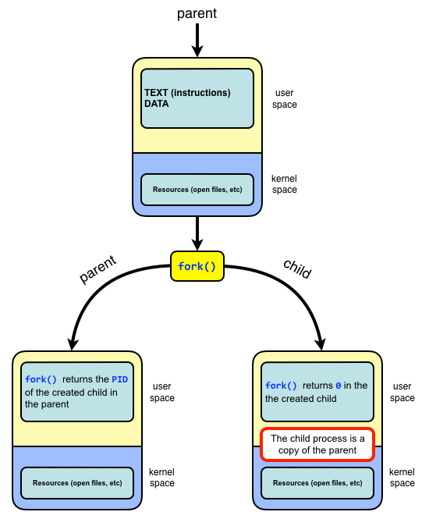
Fork illustration

Slide 12
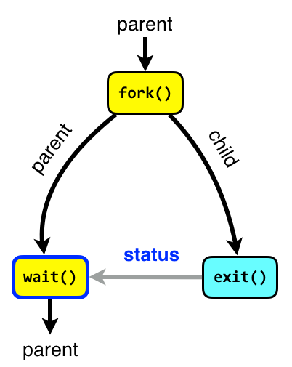
Wait
The wait system call blocks the caller until one of its child process terminates.
If the caller doesn’t have any child processes, wait returns immediately without blocking the caller.
Using wait the parent can obtain the exit status of the terminated child.

Slide 13
Process Creation
Show pstree root and pstree username
Orphans
An orphan process is a process whose parent process has terminated, though it remains running itself. Any orphaned process will be immediately adopted by the special init system process with PID 1.
Zombies
A terminated process is said to be a zombie or defunct until the parent does wait on the child.

Slide 14
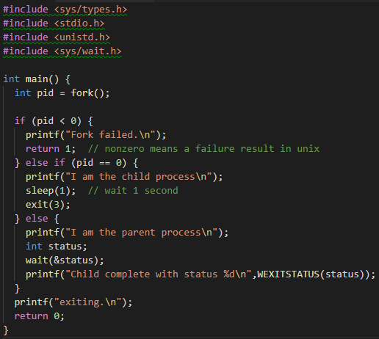
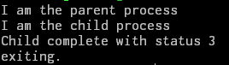
Fork example
8-bit status code.
Note that by unix tradition, a non-zero exit code signifies an error (but you can use it as you like)

Slide 15
Activity
Do the forkActivity.c

